Slide 1
2 bits ALU Peripheral and Interfacing

Slide 2
What is ALU?
ALU (Arithmetic and Logic Unit) is the part of computer processor that is used for doing arithmetic or logic operation on operands.
What is the basic use of ALU unit?
An arithmetic logic unit (ALU), a memory unit, and input/output(I/O) controllers. The ALU performs simple addition, subtraction, multiplication, division, and logic operations, such as OR and AND. The memory stores the program’s instructions and data.

Slide 3
2 bit ALU block diagram
A0
2 bit ALU
A1
F0
Here,
A(A1 A0) = operand
B(B1 B0) = operand
S(S2 S1 S0) = Select inputs
F(F1 F0) = Output
Cout = Carry output
B0
F1
B1
S0
Cout
S1
S2

Slide 4
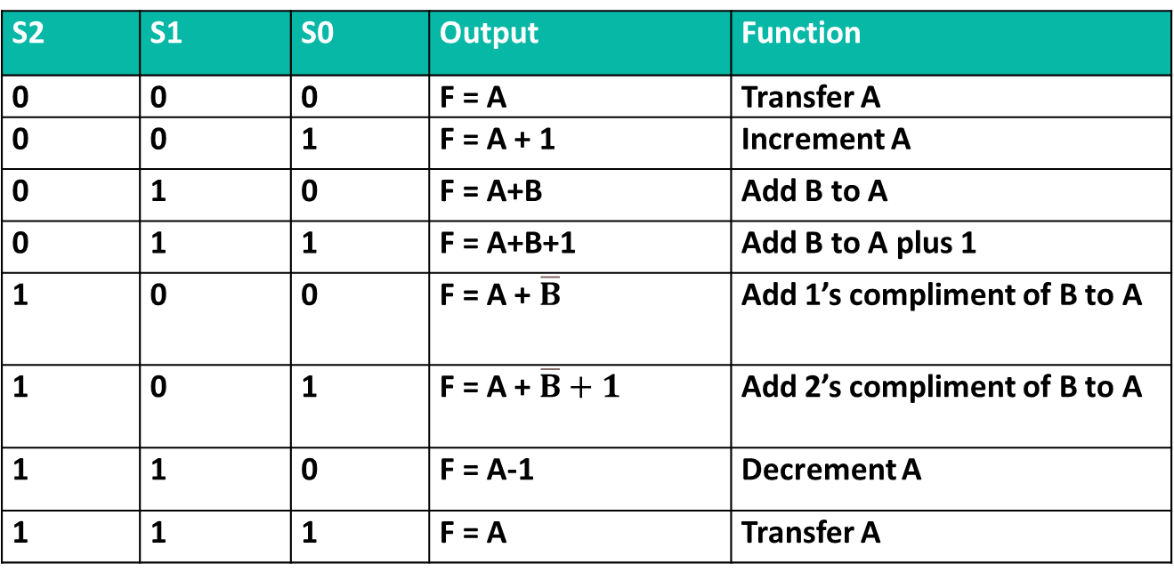
Truth Table:
S2 | S1 | S0 | Output | Function
0 | 0 | 0 | F = A | Transfer A
0 | 0 | 1 | F = A + 1 | Increment A
0 | 1 | 0 | F = A+B | Add B to A
0 | 1 | 1 | F = A+B+1 | Add B to A plus 1
1 | 0 | 0 | F = A + $\overline{B}$ | Add 1’s compliment of B to A
1 | 0 | 1 | F = A + $\overline{B}+1$ | Add 2’s compliment of B to A
1 | 1 | 0 | F = A-1 | Decrement A
1 | 1 | 1 | F = A | Transfer A

Slide 5
Now we a going to design the circuit using Proteus. To do so we have to use some pins.
We will use digital pin :
Pin num | Type | Purpose
13 | Output | F0
12 | Output | F1
11 | Output | Cout
10 | Input | A0
9 | Input | A1
8 | Input | B0
7 | Input | B1
6 | Input | S0
5 | Input | S1
4 | Input | S2

Slide 6
To design this circuit on proteus we will need:
Arduino UNO
LED
Resistor
Switch SPST
Power
ground

Slide 7
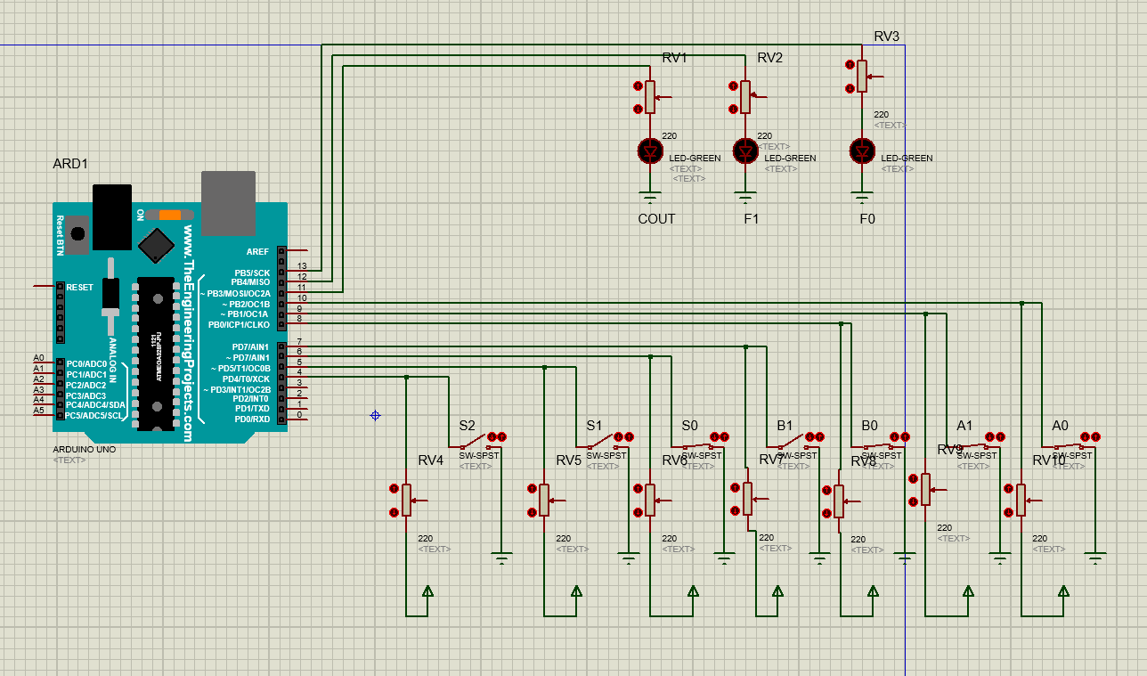
Circuit implementation using Proteus

Slide 8
Basic Knowledge we will need to implement the code:
Calculate sum and carry with half adder:
sum = A ⊕ B
carry = AB
2. Calculate sum and carry with full adder:
sum = sum = A ⊕ B ⊕ C
carry = AB + BC + CA
3. Calculate difference and borrow with half subtractor:
difference = A ⊕ B
borrow = ĀB
4. Calculate difference and borrow with full subtractor:
difference = A ⊕ B ⊕ C
borrow = BC + Ā(B + C)

Slide 9
A1
FA
F0
A0
HA
Sum0
B1
F1
B0
Carry
Carry
Cout

Slide 10
Some operation:
For S2= 0 S1 = 1 S0 = 0 out operation will be A+B
let, A = 1 1 & B = 1 1
Carry = 1 1
A = 1 1
B = 1 1
1 1 0
Here,
For A0 and B0 we use half adder:
Sum (HA) = A0 ⊕ B0 = 1 ⊕ 1=0
Carry (HA)=A0.B0=1.1=1
For A1 and B1 we use full adder , because we get a carry
Sum (FA) = A1 ⊕ B1 ⊕ Carry = 1 ⊕ 1 ⊕ 1=1
Cout (FA) = A1.B1 + B1.Carry + Carry.A1= 1.1 +1.1+1.1=1

Slide 11
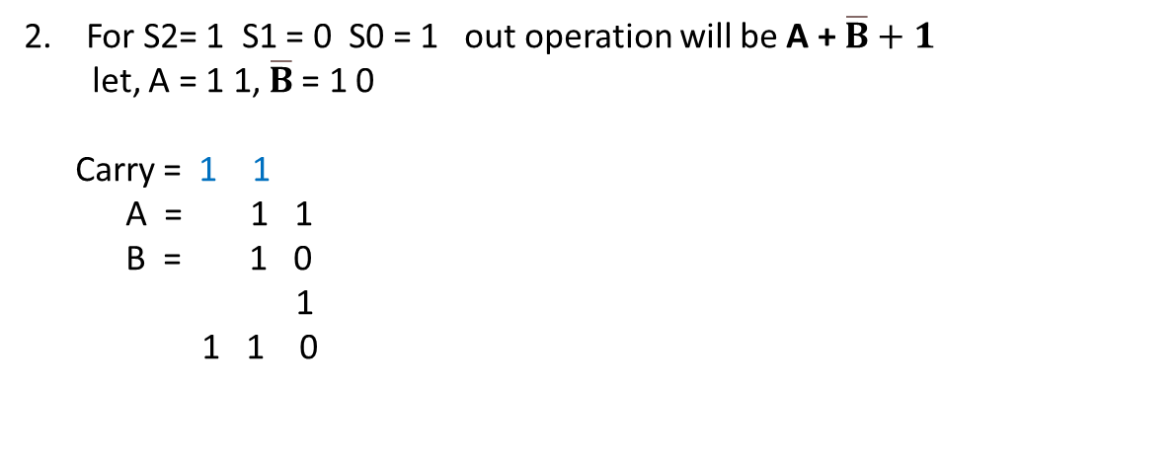
Some operation:
2. For S2= 1 S1 = 0 S0 = 1 out operation will be A + $\overline{B}+1$
let, A = 1 1, $\overline{B}$= 1 0
Carry = 1 1
A = 1 1
B = 1 0
1
1 1 0
Here,
For A0 and B0 we use full adder:
Sum (HA) = A0 ⊕ B0 ⊕ 1= 1 ⊕ 0 ⊕ 1=0
Carry (HA)=A0.B0 + B0.1 + 1.A0 = 1.0 + 0.1 + 1.1 = 1
For A1 and B1 we use full adder , because we get a carry
Sum (FA) = A1 ⊕ B1 ⊕ Carry = 1 ⊕ 1 ⊕ 1 = 1
Cout (FA) = A1.B1 + B1.Carry + Carry.A1 = 1.1+1.1+1.1 =1

Slide 12
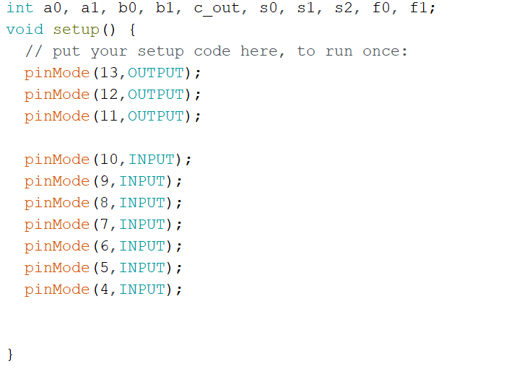
Code:

Slide 13
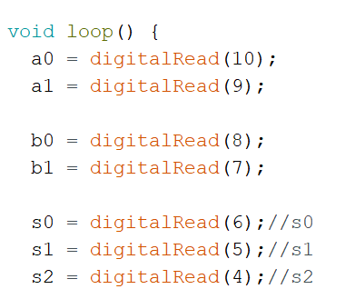
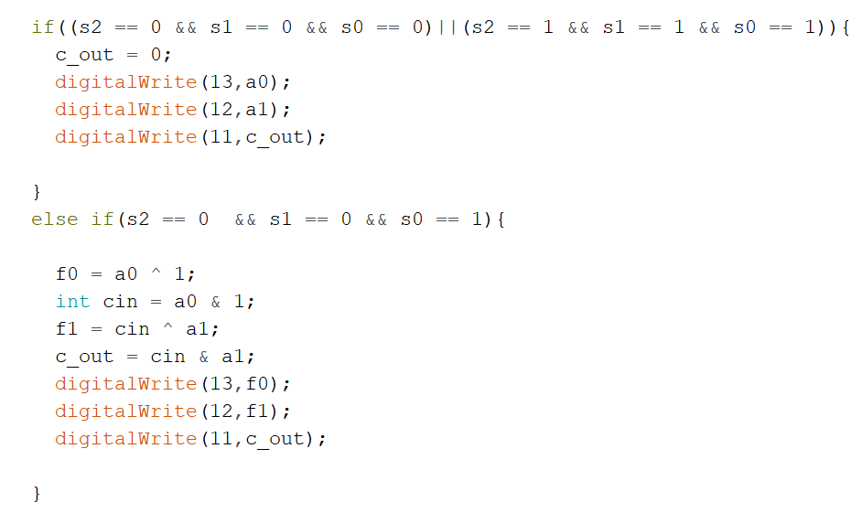

Slide 14
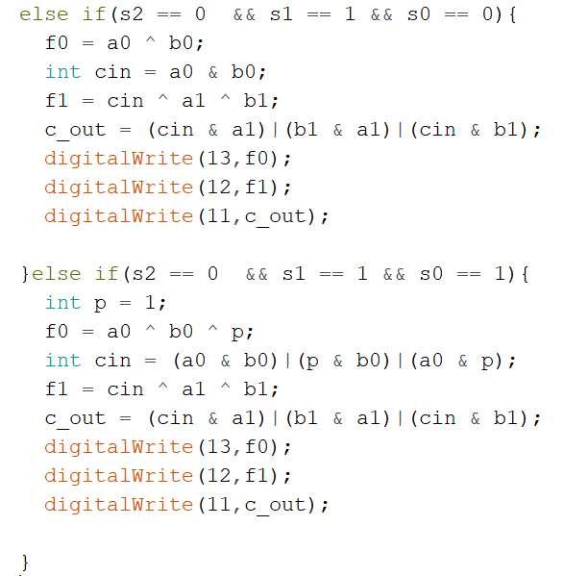

Slide 15
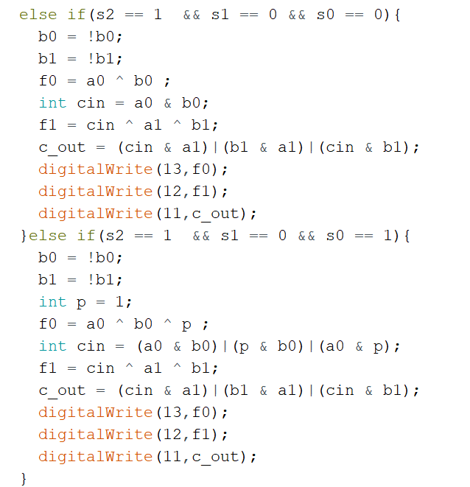

Slide 16
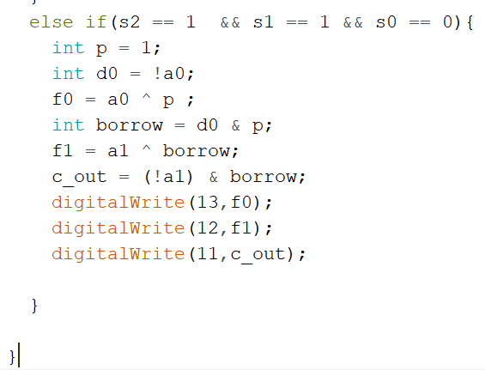

Slide 17
THANK YOU

